Slide 1

WORK-CASE №5
Create: Chehk Ivan, Dzyzyl Denis

Slide 2
Consider the questions and answer them:

Slide 3
При роботі з персональним комп’ютером дуже часто виникає необхідність підключати периферійне обладнання. На прикладі принтера та флешки опишіть який механізм має ОС Linux для роботи з ними.

Slide 4
Automatic recognition:
When you connect a printer or flash drive to a computer via a USB port, Linux automatically recognizes these devices and installs the appropriate drivers. You don't need to make complicated settings.
Виконав Чех І.В.

Slide 5
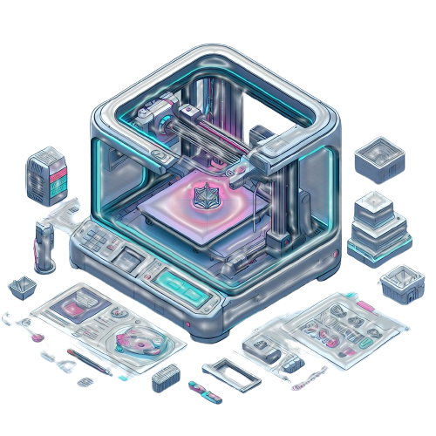
Working with the printer:
After connecting the printer, you can print documents from various programs by choosing from a list of recognized printers.
This process is also automated.
Виконав Чех І.В.

Slide 6
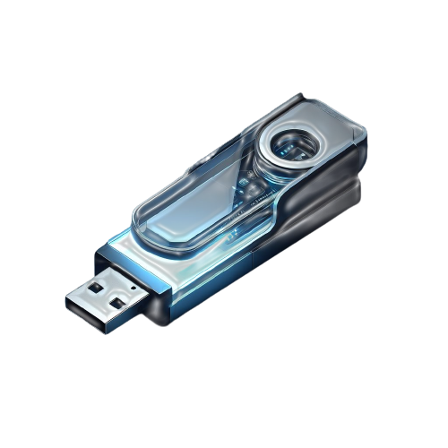
Working with a flash drive:
The flash drive is automatically mounted after connection and becomes available for reading and writing. You can browse and copy files from it using the file manager, and you don't need to take any additional actions.
Виконав Чех І.В.

Slide 7
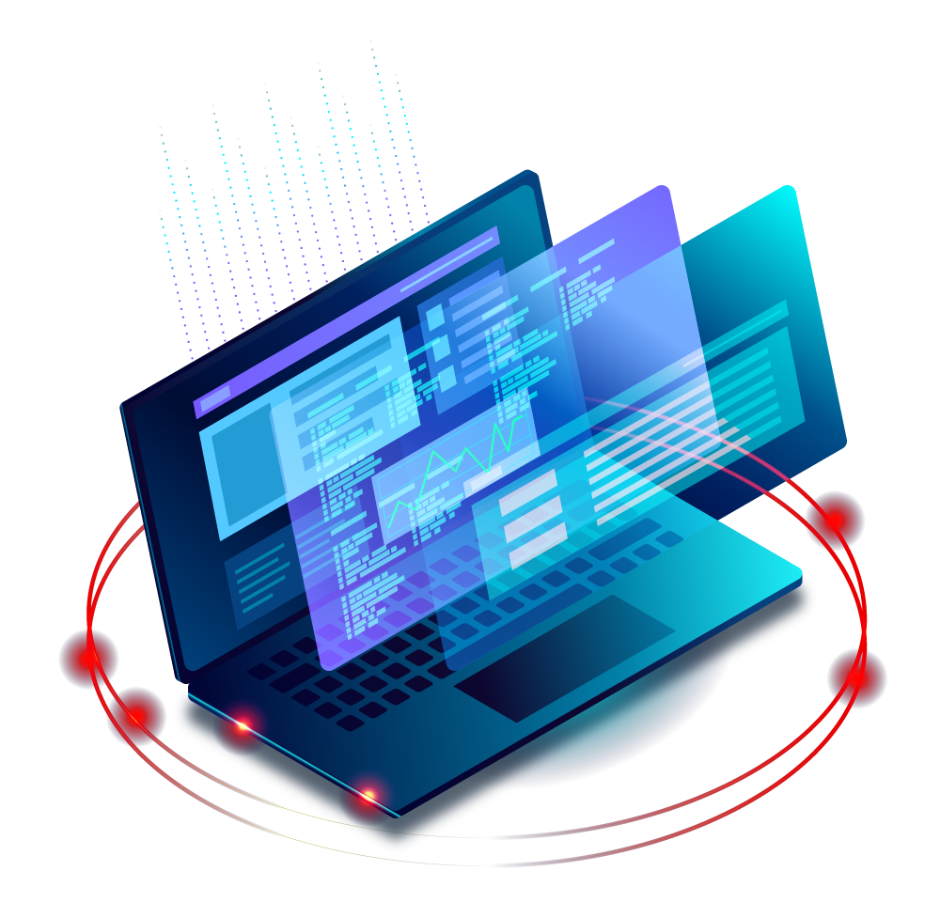
Mounted devices:
If you want to find your connected flash drives and other external devices, you can go to the "/media" folder. Here you will find available devices and be able to work with them.
Виконав Чех І.В.

Slide 8
В чому суть операції монтування, для чого вона використовується та як?

Slide 9
A mount operation in Linux is the process of attaching a device's file system to a specific point on the system in order to access data on that device. Once mounted, the data is available and can be viewed and edited. After you have finished working with the device, it should be unmounted for safety.
Виконав Чех І.В.

Slide 10
В чому різниця при роботі з периферією у ОС Linux та ОС Windows?

Slide 11
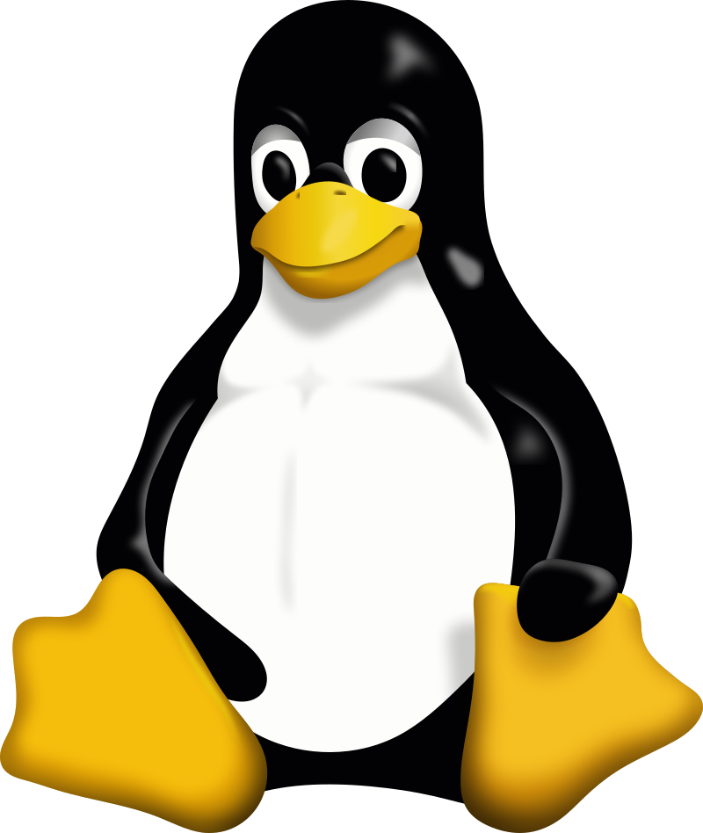

Drivers:
Linux: Usually already built-in.
Windows: You usually need to install drivers separately.
Mounting flash drives and external drives:
Linux: Usually mounts devices automatically.
Windows: Sometimes you need to choose an opening option.
Виконав Чех І.В.

Slide 12
Availability of programs:
Linux: Free and open source alternatives for many applications.
Windows: More commercial applications.
User interface:
Linux: More emphasis on command line and flexibility.
Windows: Simplified GUI for most users.
Виконав Чех І.В.

Slide 13
Підключіть до вашої віртуальної машини зі встановленою ОС Linux флешку та принтер (за можливості) та через графічний інтерфейс скопіюйте один файл з флешки на віртуальну машину та роздрукуйте його (такі ж самі дії повторіть, але з іншим файлом через команди в терміналі).

Slide 14
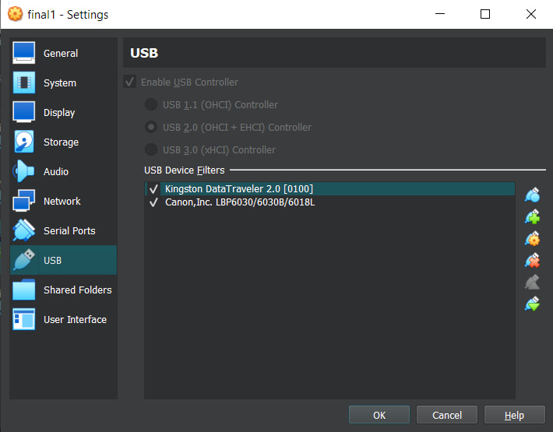
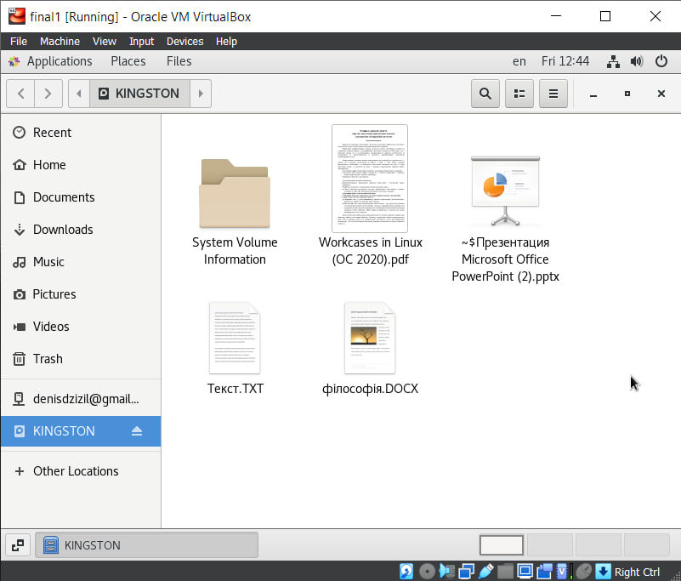
Виконав Дзизиль Д.Є.
To connect the flash drive and printer, open the virtual machine's settings, go to the USB menu, click on "Adds new USB" then add a flash drive and printer. After that, you can start your virtual machine and this devices will be connected.

Slide 15
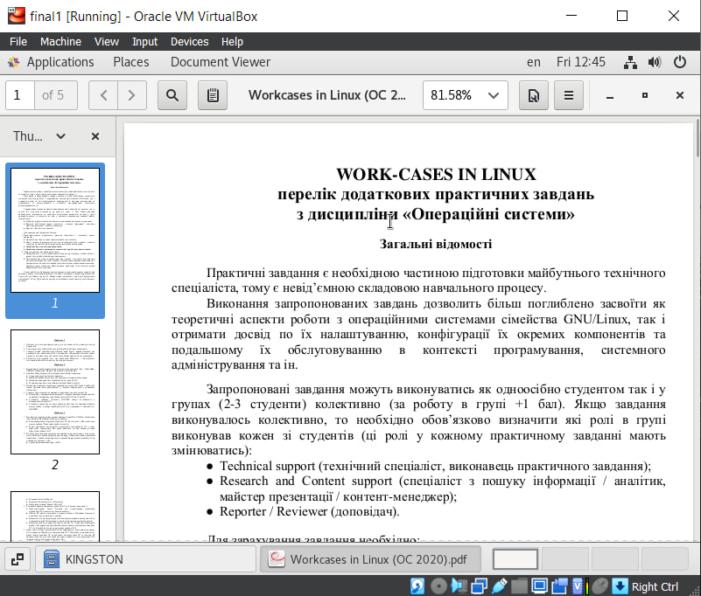
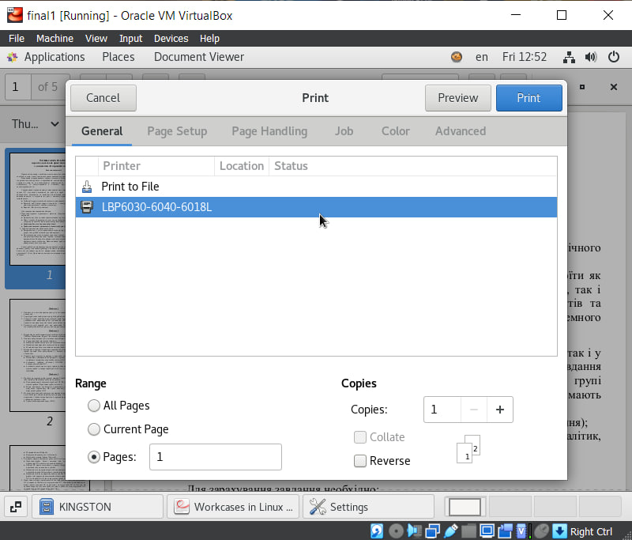
Виконав Дзизиль Д.Є.
To print a file on CentOS 7 GNOME you need to open the file, that you want to print, then click on the File button after that you need to adjust print settings and click on the Print button.

Slide 16
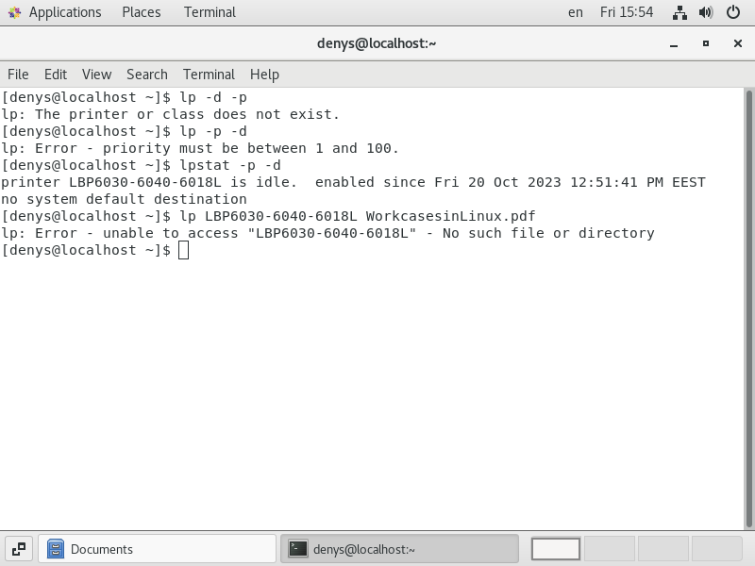
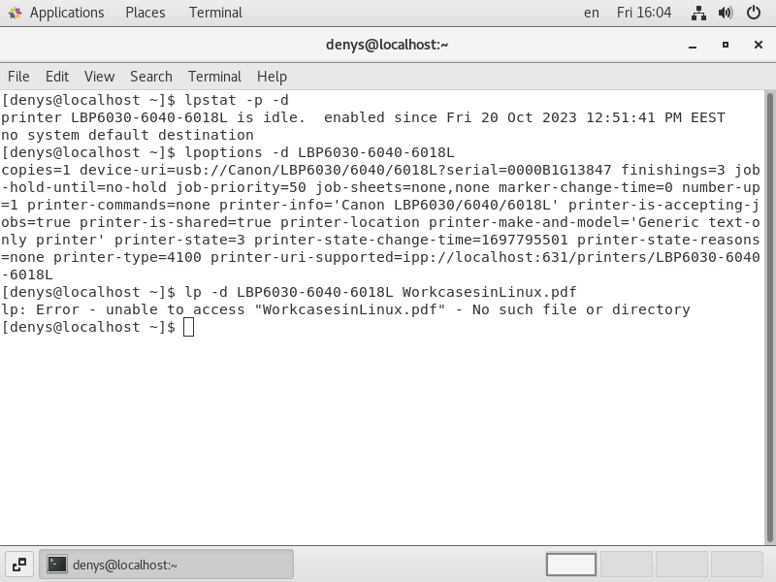
Виконав Дзизиль Д.Є.
To print a file on a CentOS 7 GNOME terminal you need to check available printers by command lpstat -p -d. Then use this command lp -d printer_name file_to_print, your file will be printed. In my case, I can't print this file because there is no access to the file, but there is nothing that I can do with it.

